Slide 1
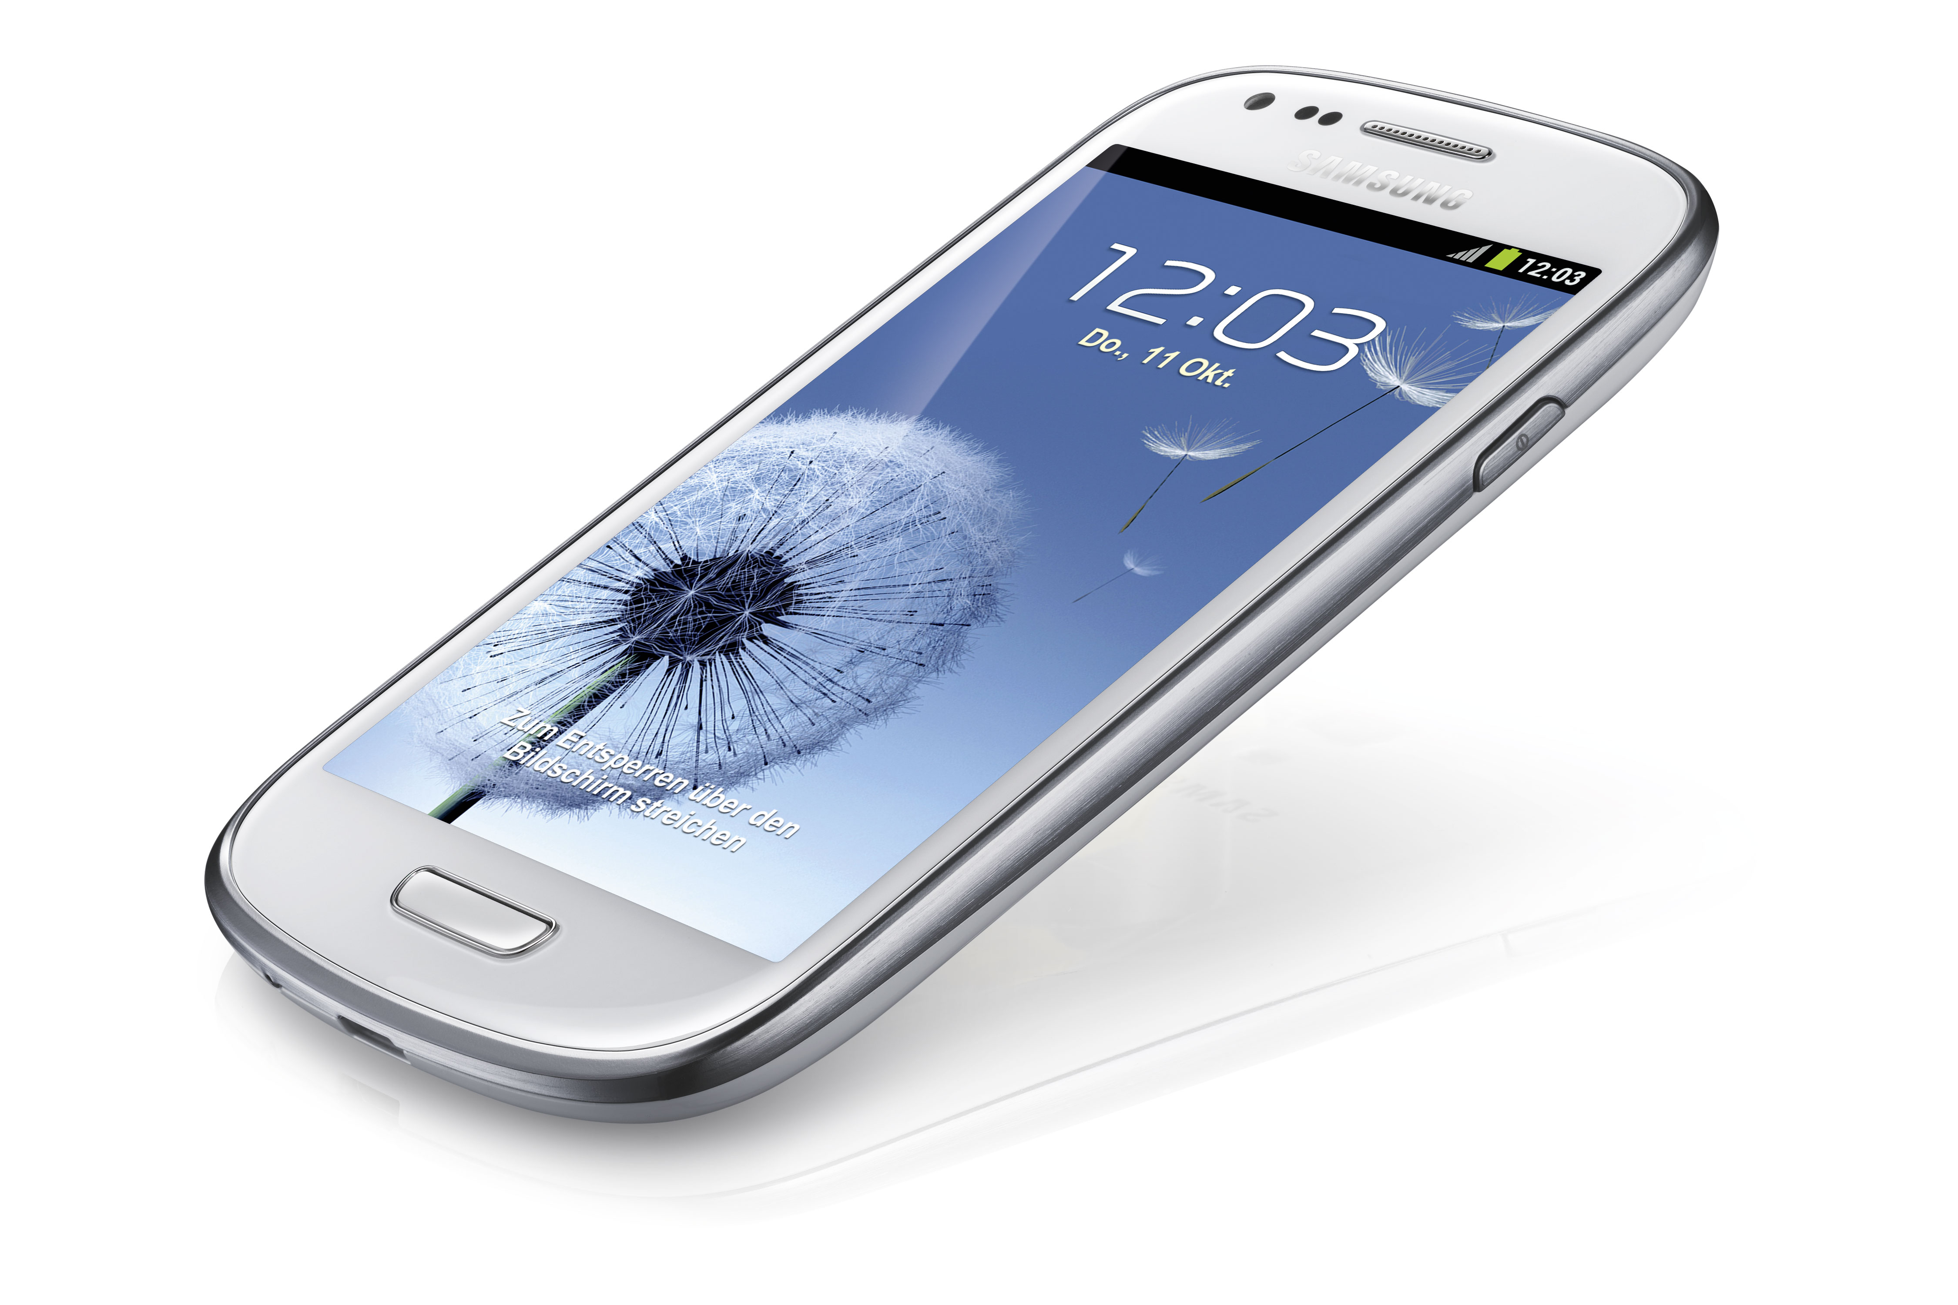
Mobile Data collection

Slide 2
Process of Mobile Data Collection

Slide 3
Steps Involved in An Evaluation Study
Planning and Designing
Testing
Field data collection
Data entry and Analysis
Reporting and Dissemination
ToR development
Recruitment
Desk Review
Designing (+sampling) and planning
Questionnaires and tools development
Field enumerator/ data collector training
Field pilot testing of tools
Tools finalizing
Data quality assurance and supervision
Database construction, analysis plan

Slide 4
Additional Steps for Mobile Survey
      + Select type of apps to be used
      + Procure appropriate tablet/ mobile phones enough for enumerators
      + Set-up survey questionnaires in selected app
      + Test→ Test→ Test→ Test … before actual implementation
      + Integrating mobile data collection topic into enumerator training
      + Thorough field testing and finalizing the app

Slide 5
Most Importantly
Getting a final question set is the most important part before the development of a mobile app

Slide 6
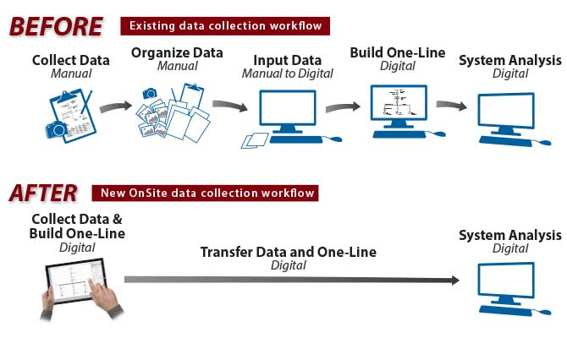
Differences During The Data Collection Process

Slide 7
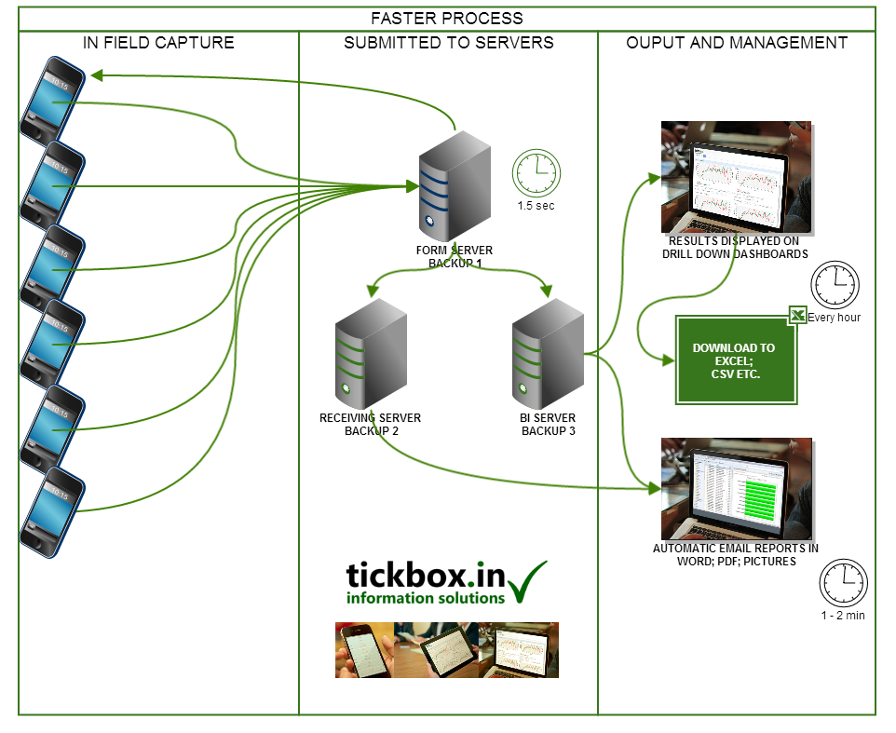

Slide 8
Strengths
No need to key-in the data again
Timely data availability
Can see descriptive figures once data is uploaded
Can reduce interview errors e.g. skipped questions, rules for numerical data, etc.
Adjustable screen view
Can record audio/ video data during data collection

Slide 9
Limitations
Cost of purchasing devices (but if there is long-term data collection plan it is cost effective)
Might have some unpredictable technical issues/ data lost in the field
No data back-up
Longer duration of data collection
Difficult for the supervisors to check the data quality

Slide 10
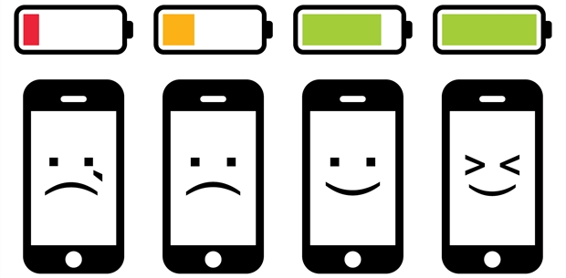
Tips for Mobile Data Collection
Phone Power
  Charging & Power bank
  Caution about the use of
  other Apps that can drain the battery
  (e.g. GPS, WIFI)
  Off-line/ airplane mode
Phone Error
  Phone software errors and touch screen errors
  Keyboard errors (especially when collecting the data using Myanmar font)

Slide 11
Personal Safety and Device Security
Data Security
  Value of data inside each device
  Data transfer process
  Take care when deleting the data
Internet Connectivity
  Requires mainly during planning and designing phase
  Intermittently during the data collection period for regular data sending
  Can use with offline mode in the field

Slide 12
Apps for Mobile Data Collection
A lot – e.g.
SurveyMonkey https://www.surveymonkey.com/
KoBo http://www.kobotoolbox.org/
magpi http://home.magpi.com/
HARVESTYOURDATA https://www.harvestyourdata.com (can use in both android and iphones)
And many others …...

Slide 13
KoBo
INTERNET!!! (Guest Wifi, password: UNOPS4guests)
Use your laptop (initial stages require a laptop/ computer)
***Open source and free***
Developed by Harvard Humanitarian Institute in collaboration with the UN and International Rescue Committee
Launch in Sept 2014

Slide 14
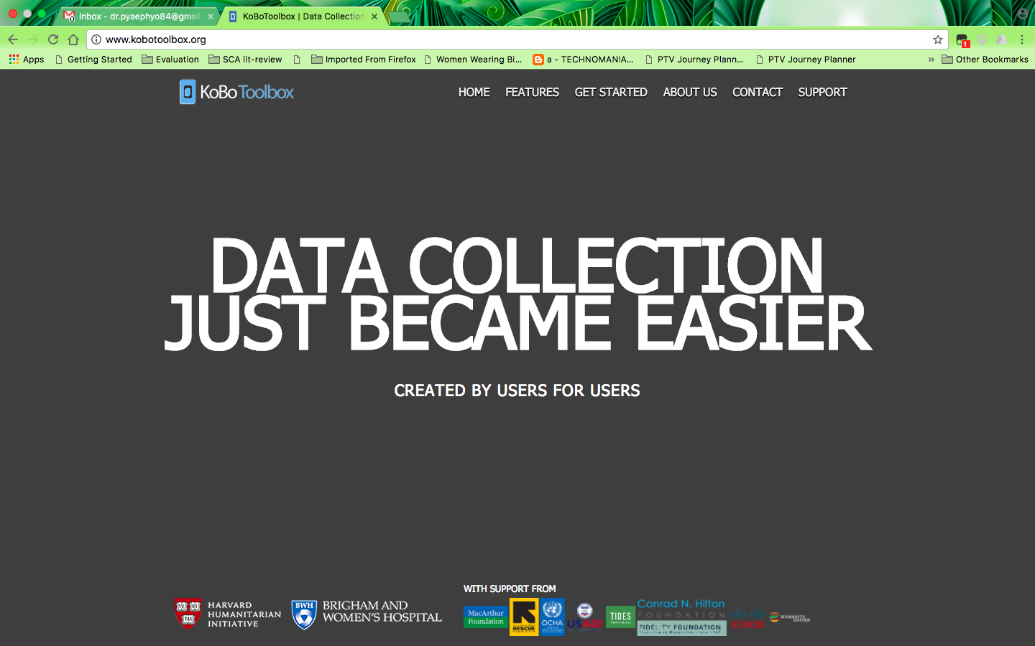
Create an account from http://www.kobotoolbox.org/

Slide 15
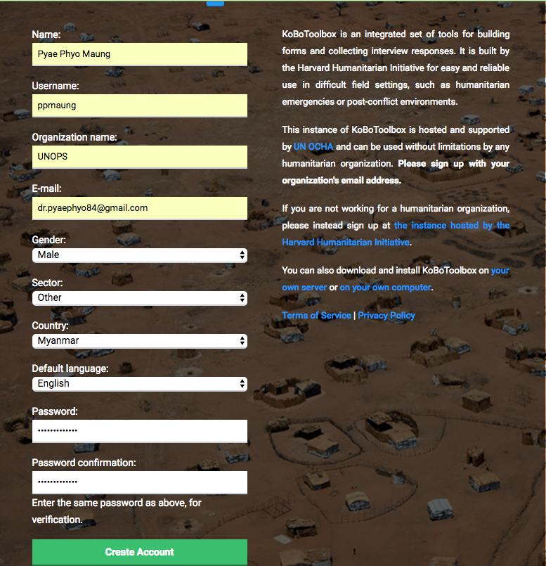
Personal information for creating an account: name, username, organization name, email*, gender, sector, country, default language, password

Slide 16
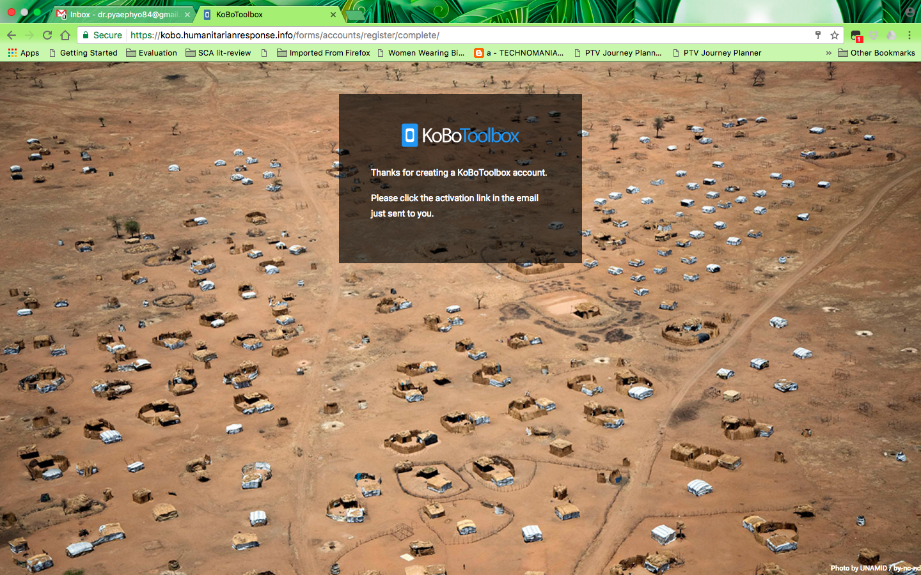

Slide 17
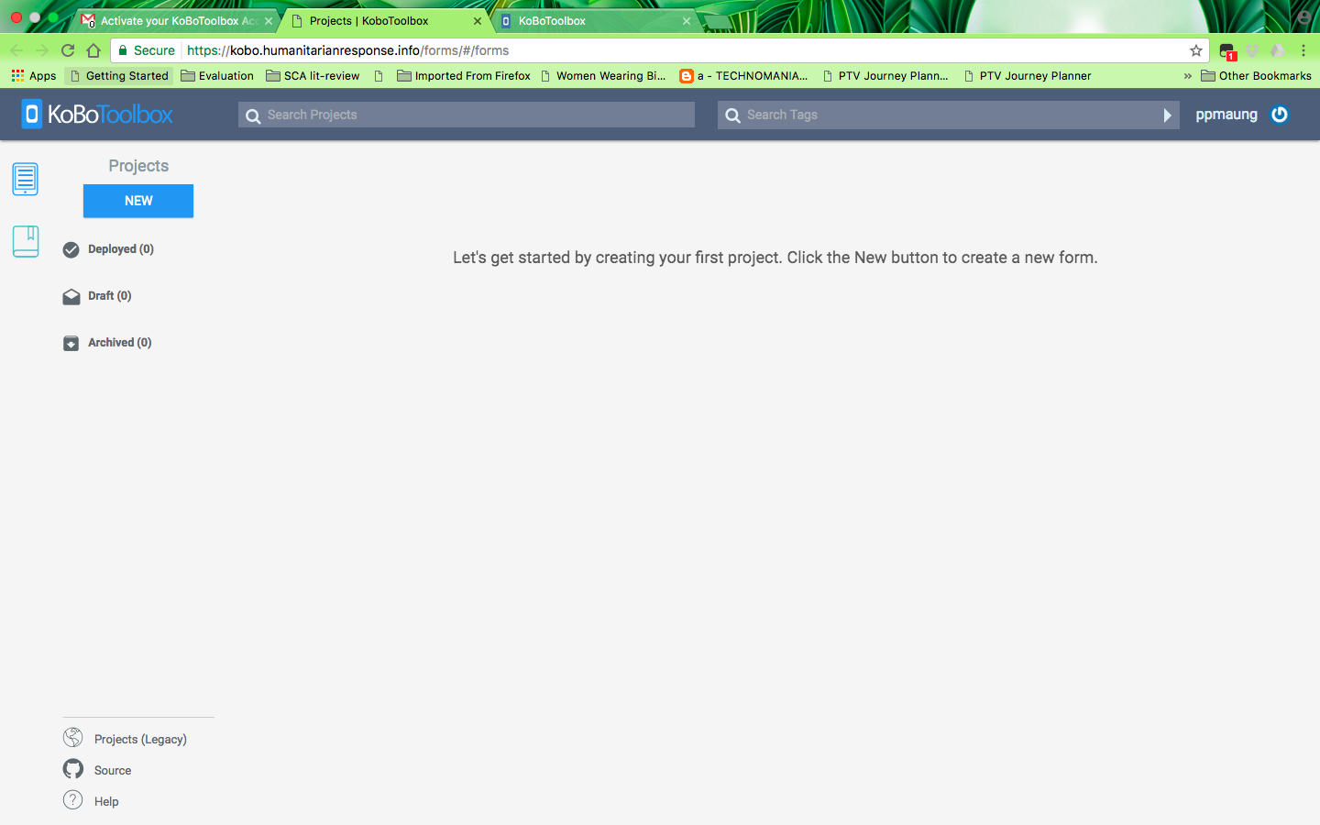
Create a new project in a newly created account

Slide 18
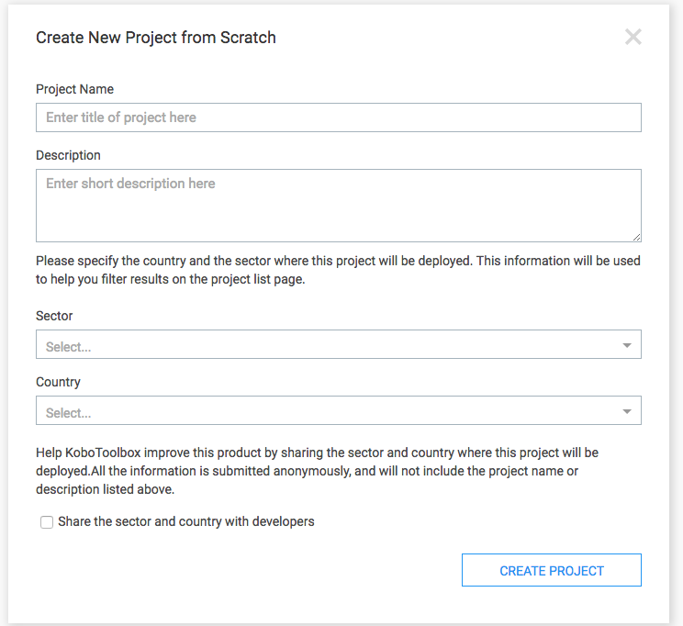
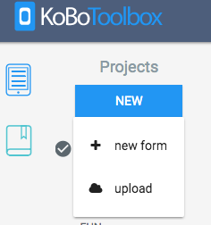

Slide 19

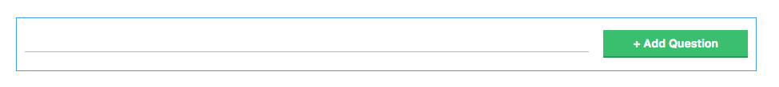
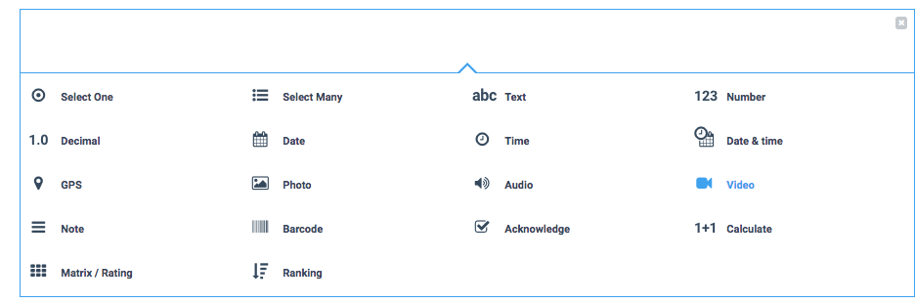
Creating Questions

Slide 20
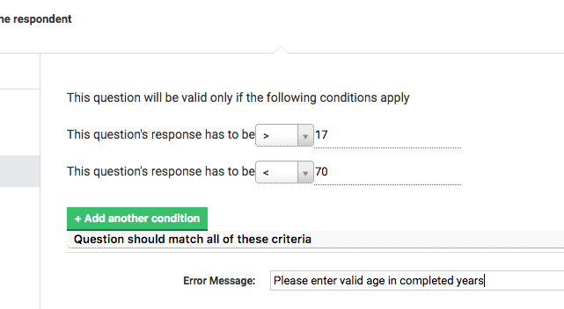
Number setting (Validation criteria)

Slide 21
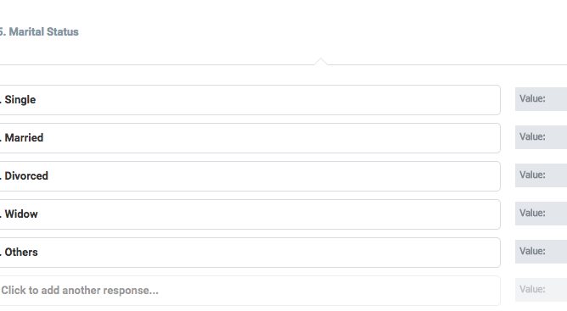
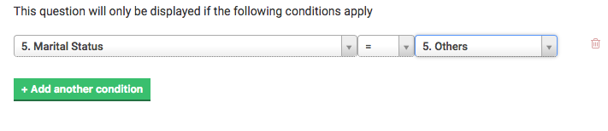
Single Select and Others

Slide 22
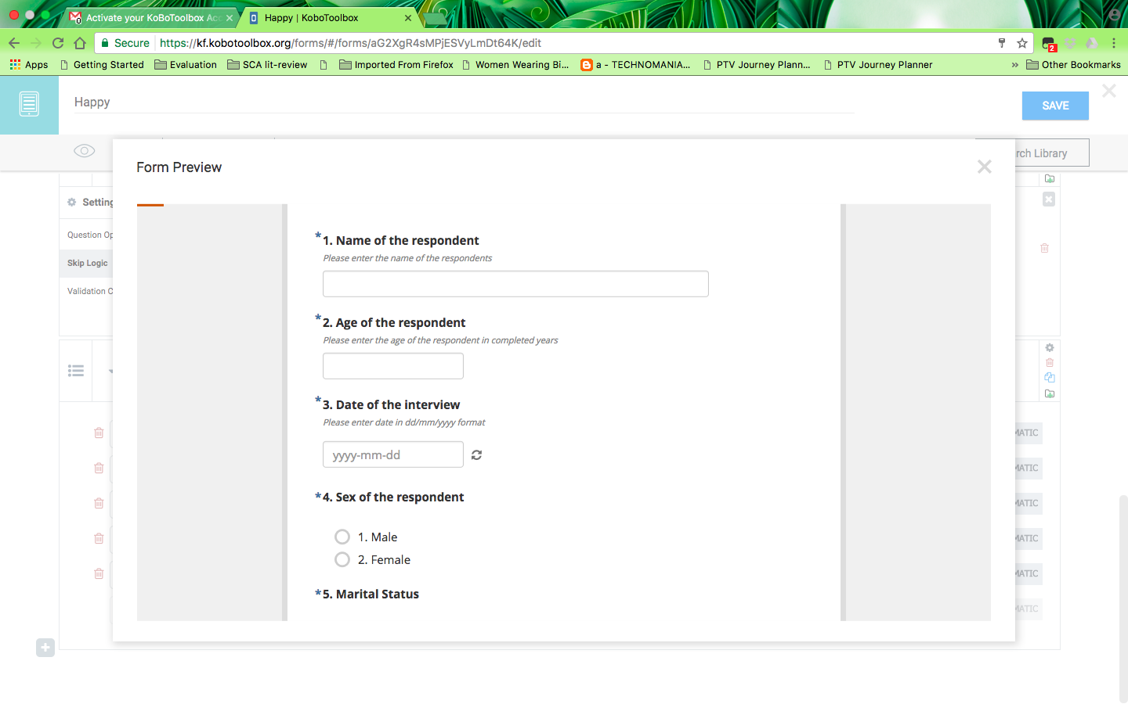
Preview

Slide 23
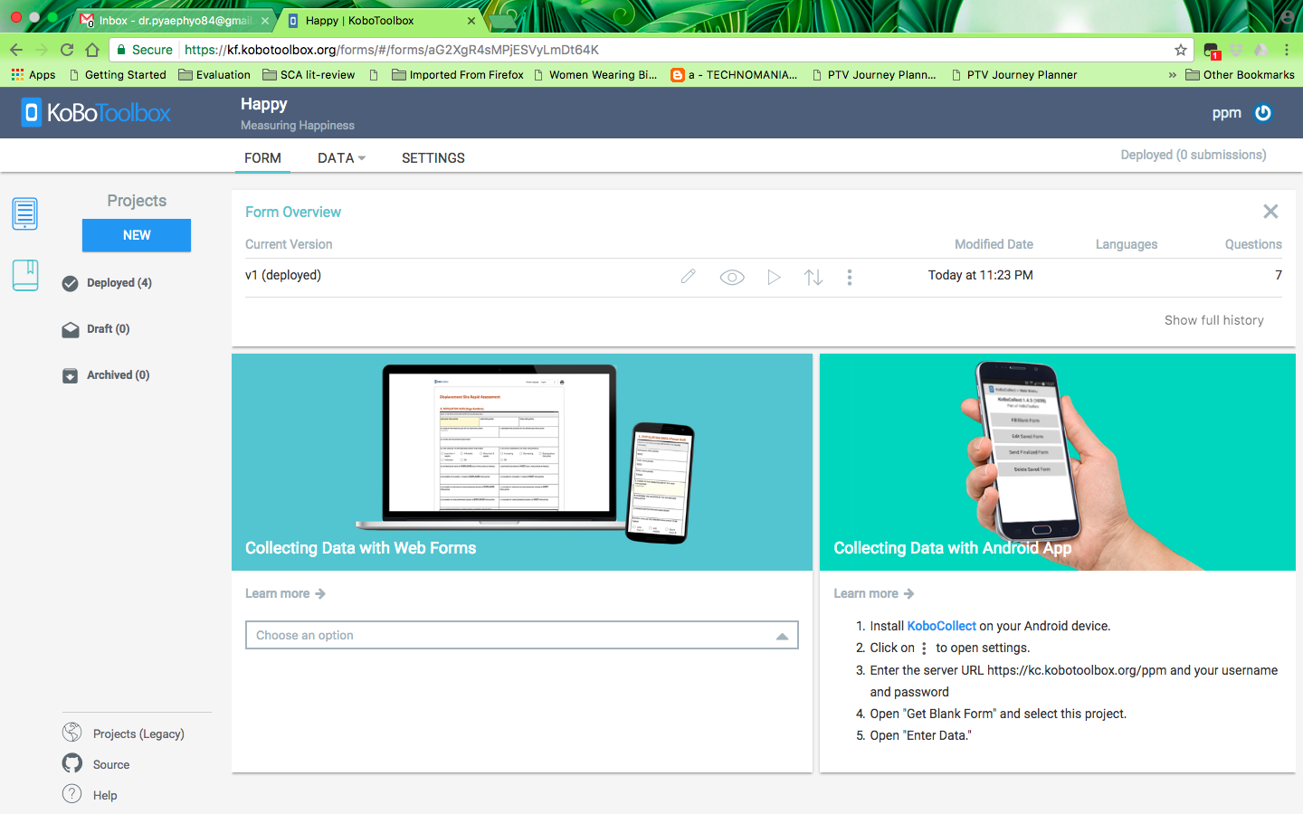

Deploying

Slide 24
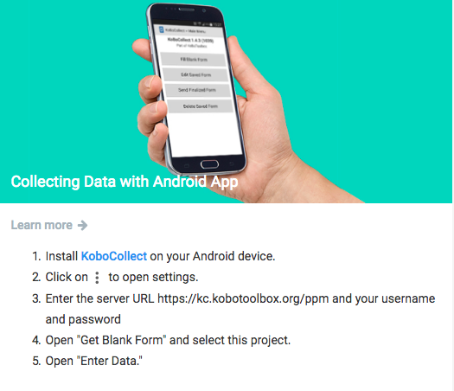
Data collection by phone

Slide 25
Setting up KoBo App in Phone
INTERNET!!!
Install ‘KoboCollect’ in your mobile phone or tablet
If you do not have it already, then please download it from GooglePlay or go to this link https://play.google.com/store/apps/details?id=org.koboc.collect.android&hl=en
Go to App’s General Setting
Change server URL https://kc.kobotoolbox.org/ppm
username and password [Username:, Password:]
Check other settings: Disable ‘Auto send with wifi and network’ and ‘delete after send’.
Click "Get Blank Form”. Select appropriate form.
If you are ready to collect data, then click "Fill Bank Form”. Then select appropriate form/ project again.
Once you have downloaded the form in the phone, you can turn of the wifi/ change the device setting to airplane mode.

Slide 26
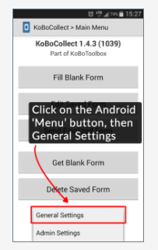
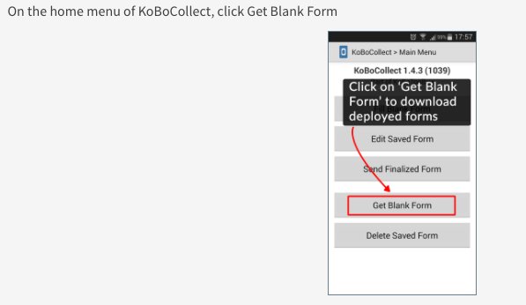
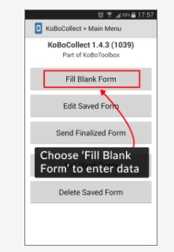

Slide 27
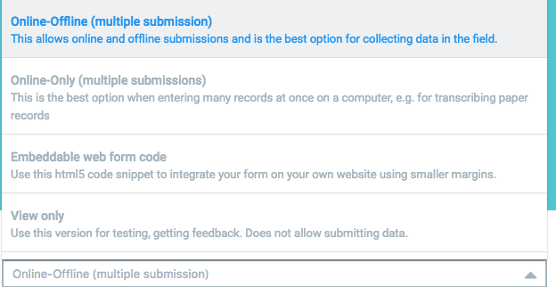
Data Entry Using Computers

Slide 28
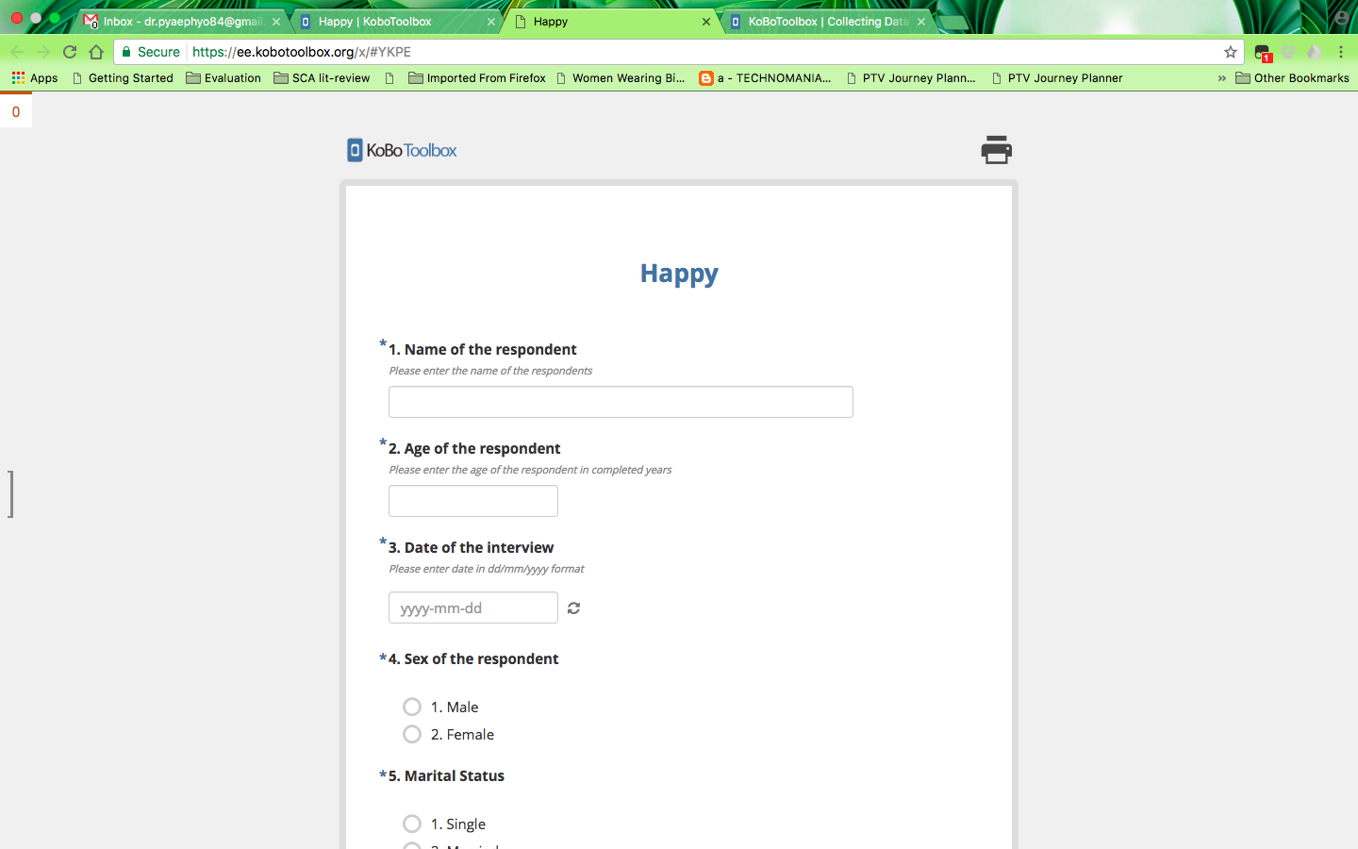

Slide 29
Sending Data from Mobile Devices
Before sending the answer files, check the completed data. By using Prompt Question tab in each answer file, the enumerator or supervisor can check the specific questions and revise the answers if needed.
When finished, it needs to click ‘Save form and exit’. Once you click ‘Save form and exit’, it appears 1 in Send finalised form tab in KoBo Main menu.
For sending, turn on the internet! Click Send Finalised form. Select unsent forms and click send.

Slide 30
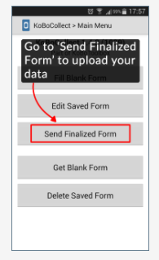

Slide 31
Reviewing The Completed Data And Downloading The Data File
https://kf.kobotoolbox.org/forms
Select specific project title→ go to data tab→ report/Table→ Can check data
The data file can be downloaded as Excel file. For more complex analysis using statistical software such as SPSS, it needs to expose again into these software.

