Slide 1
Overview on Randomized Controlled Trials
Fabrizio Santoro – Research Associate
Innovations for Poverty Action (IPA), Myanmar
Version 1.0 | April 2016
Created by: David Batcheck
comms@poverty-action.org

Slide 2
Outline
Economics as a Science
What is causality?
The identification strategy
IPA and RCTs
  Basic features
  Pitfalls of RCTs
  Critiques of RCTs

Slide 3
Economics as a Science

Slide 4
Economics as a Science
Economics historically more interested in theory
In the last 20 years: Revolution of Testing
Scientific Method approach:
  Propose hypothesis
  Come up with means of testing hypothesis using real world data
  Reject hypothesis if test fails; consider it plausible if test passes
  Quantify the impact of the program
  Iterate to better understand the world
Economics plays a key role in directly informing policy-making

Slide 5
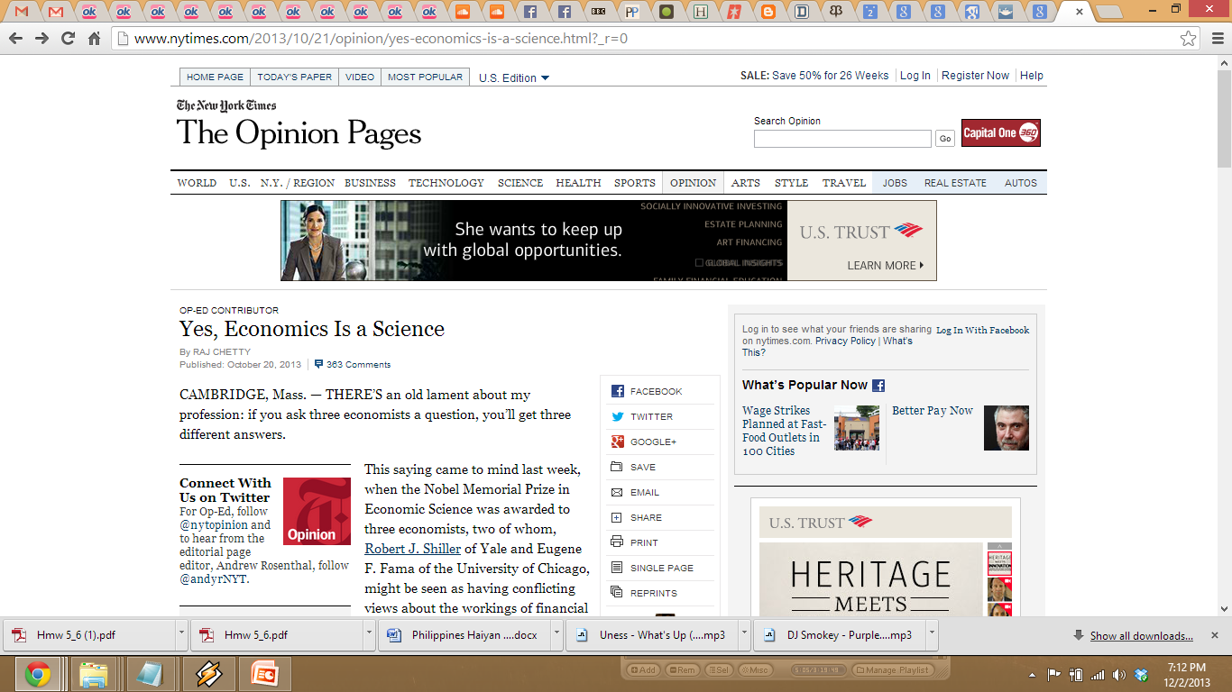

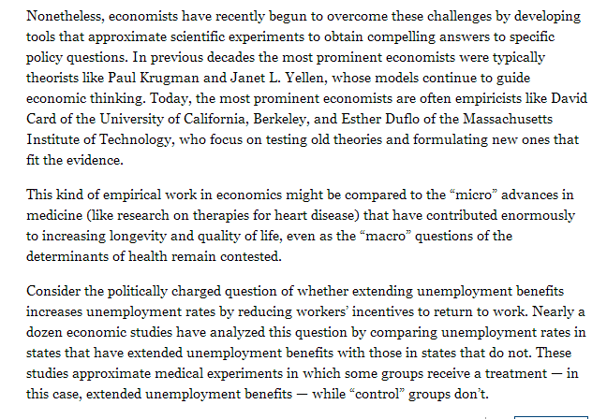
Esther Duflo as one of
Time Magazine’s
100 Most Influential People
(2011)

Slide 6
What is causality?

Slide 7
We make causal statements everyday!
Many of the questions we want to answer in economics/social science are policy-relevant causal questions:
  Does immigration lower the wages of the native workers?
  Does microloans increase business activity?
  Does providing fertilizers increase farming output?

Slide 8
Causal Inference and Programs
Why do economists care so much about causality?
Primarily concerned with the questions:
  Can we attribute the change we see to this specific program?
  Can we test the actual impact of the program?
Main goal: to predict what’s going to happen if you enact a specific policy – likely causal impacts
Any M&E professional should care about the issue of causal inference!
  Traditional baseline-endline comparison doesn’t necessarily show causality!
If two variables move in the same way doesn’t mean one causes the other

Slide 9
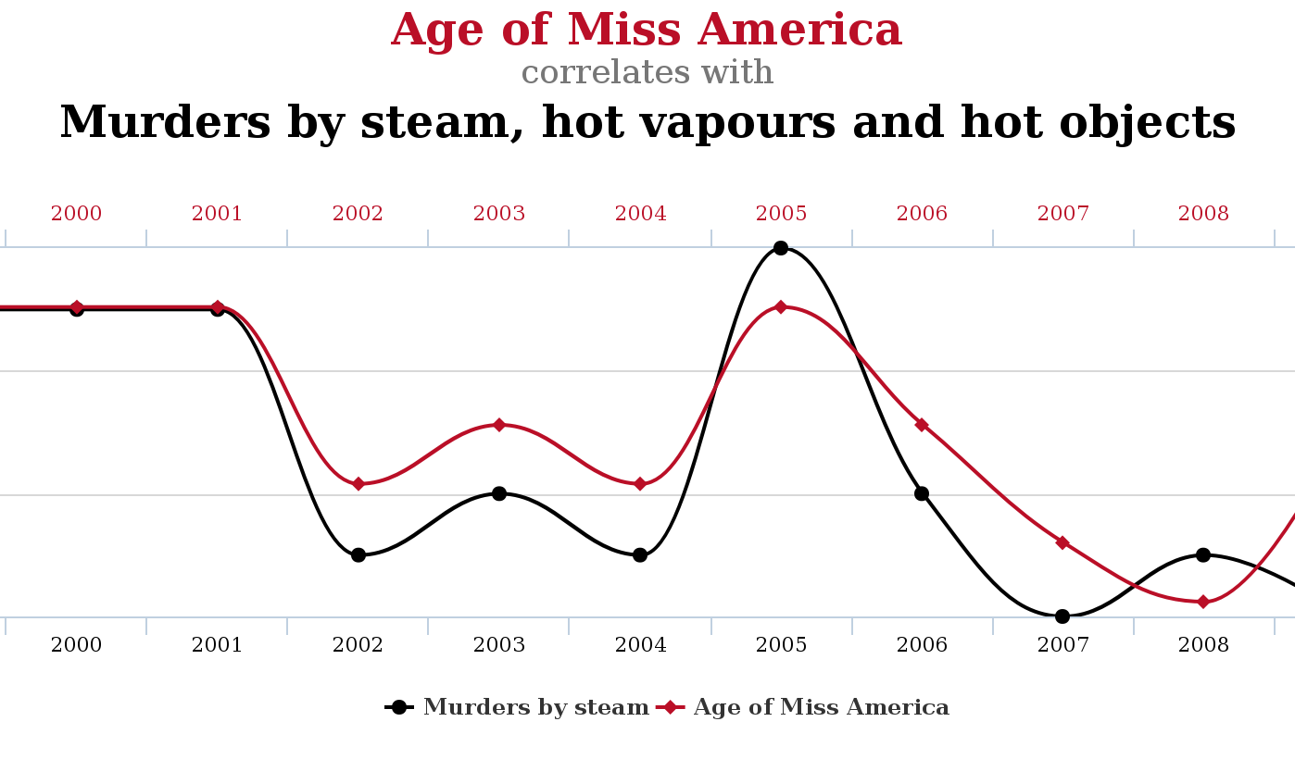
Correlation doesn’t imply causation!

Slide 10
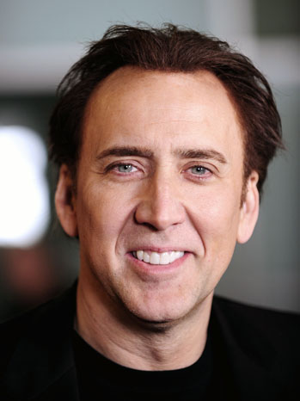
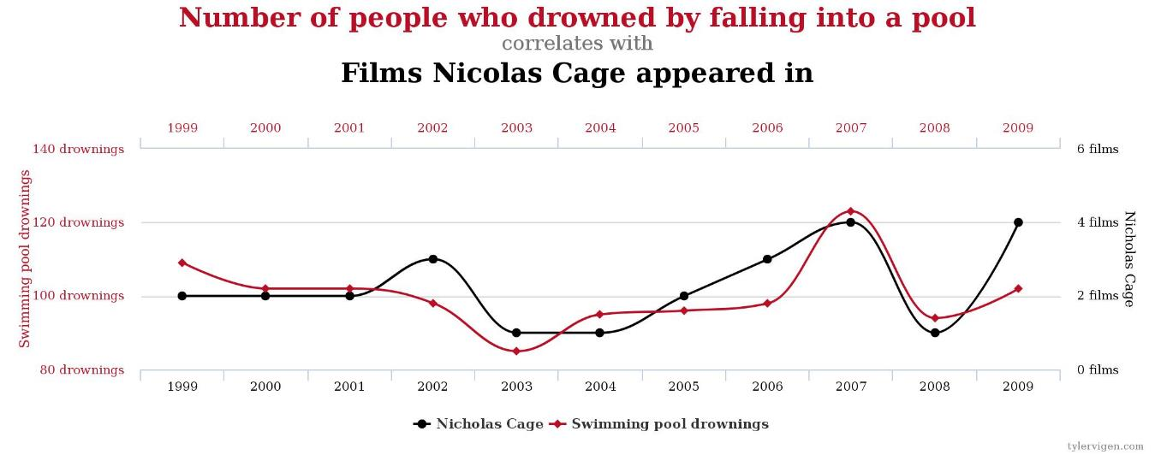
Correlation doesn’t imply causation!

Slide 11
The Identification Strategy

Slide 12
Identification
In order to confidently say that one event causes a specific outcome we need to have an identification strategy
Y outcome we care about (i.e. school attendance)
X is some variable which influences Y (i.e. free books)
How fairly can we say that free books increase attendance?
We create a scenario in which we observe and measure both the factor and the outcome in a given setting – a test
It can be difficult! Many outcomes are jointly determined - i.e. hh income, parents’ education and distance to school have an impact on school attendance!
When we can eliminate other factors that might contribute to that outcome, we say have a well identified strategy: we can actually say that free books is increasing attendance
Very valuable when you are able to do it: this will bring to better policy-making!
Best identification tool: RCTs – IPA pioneered RCT methodology in economics

Slide 13
IPA and RCTs

Slide 14
Innovations for Poverty Action
founded in 2002 by Yale professor Dean Karlan
extensive network of more than 400 economists from among the top universities
over 240 evaluations in progress
20 country offices
Mission:
  1. To create high quality evidence: specialize in randomized controlled trials (RCTs) to test central economic theories
  2. To help turn that evidence into better cost-effective programs and policies for the poor

Slide 15
What is a Randomized Controlled Trial (RCT)?
Gold standard – best identification strategy
Randomly assign eligible units (people, firms, schools) to receive or not receive a treatment/intervention
Random assignment ensures that participants in both groups are comparable at the outset of the study (ex. similar proportion of educated/uneducated) – self-selection in programs is based on criteria that often contribute to the final outcome
RCTs are ideal for answering causal questions - they create two groups that, on average, are virtually identical to each other
  Before the program identical to each other
  After the program we expect a difference caused by the program
  Difference in outcomes can be causally attributable to the program!
Notes:
An RCT is the same methodology used in high quality medical research. It relies on the random assignment of a program or policy to measure its impact on those who received the program and those who did not.
RCTs provide the most credible and reliable way to assess the true impact of an intervention.
If we want to know how effective a program is, we need to have a comparison group. Without a comparison, we can't really say anything about what would have happened without the program. And the only way of having a fair comparison group is with random assignment.
With random assignment, each person in the study has the same chance of being assigned to a group as another person. This ensures that as long as the two groups are large enough, they will on average be statistically identical. Any change which we then observe between the two groups can be attributed entirely to the program or intervention itself, rather than other external or unobserved factors.

Slide 16


Random assignment into
treatment groups
Receives
treatment
Receives
placebo
Comparison of outcomes
Notes:
Have people suggest ways.
Coin flips; every other person “A” “B” “A” “B” etc; dividing based on last names
How do we do if we want to ensure we have the same number of people in each group?

Slide 17
Pitfalls of RCT
  Attrition
    A big problem if unequal across groups – control people are less motivated to remain in the study
    You don’t know if the portion that you lost had some characteristics that might influence that outcome
  Implementation fidelity
    Monitoring!
  Spill over effects
    Participants do not conform to the treatment/control for whatever reasons
Notes:
How do you minimize attrition?
Tracking respondents – ensuring that right person is being surveyed
DISCUSSION – what do you guys do? Have you had bad or good experiences with attrition?
It is not really possible to address spillovers during data collection, must be done at design level
Could randomize at cluster level
Could have pure control market centers/villages to measure spillover effects
Another example is DEWORMING and how spillovers were likely to occur so randomization was at school level

Slide 18
When RCTs are not possible
Randomized experiments are often implausible
  Cost reasons
    Even small RCTs are expensive
  Moral reasons
    Uncomfortable to give benefit to someone while preventing others
  Logistical reasons
    We can’t randomly assign good institutions, or favorable geography, or social norms, or…
Chief criticism: external validity bias!
Carry programs across settings, populations – ex. microfinance program from India to Peru
Despite this, RCTs are considered the best tool and we’re happy to show you our current experience with it!

Slide 19
References
Duflo, Glennerster, & Kremer. (Jan 2007). Using Randomization in Development Economics Research: A ToolKit. Discussion Paper Series No.6059.Center for Economic Policy Research. Retrieved from http://economics.mit.edu/files/806
Imbens and Rubin, Causal Inference for Statistics Social and biomedical Sciences

Slide 20

Thank you!
Questions?

